Slide 1

CONEXXA
A Student Company Recommendation System
Presentation By:
Abhinavu Prasad
Dharshana.S

Slide 2
Problem Statement
The absence of personalized company-student pairing in placement and internship programs leads to ineffective opportunities and missed career growth. Without structured matching systems, student skills are often misaligned with company requirements. This mismatch hampers students' professional development and limits companies' access to suitable talent, necessitating a data-driven, skill-based solution for more effective and structured pairing between students and companies.

Slide 3
Introduction
Conexxa is a cutting-edge mobile application designed to revolutionize the way students connect with companies for internships and job placements. By focusing on personalized, skill-based matches, the app enables students to create detailed profiles that highlight their academic background, career goals, and skill sets.
This ensures that students are paired with companies that align with their qualifications and aspirations, resulting in more meaningful opportunities and better talent acquisition for companies.

Slide 4
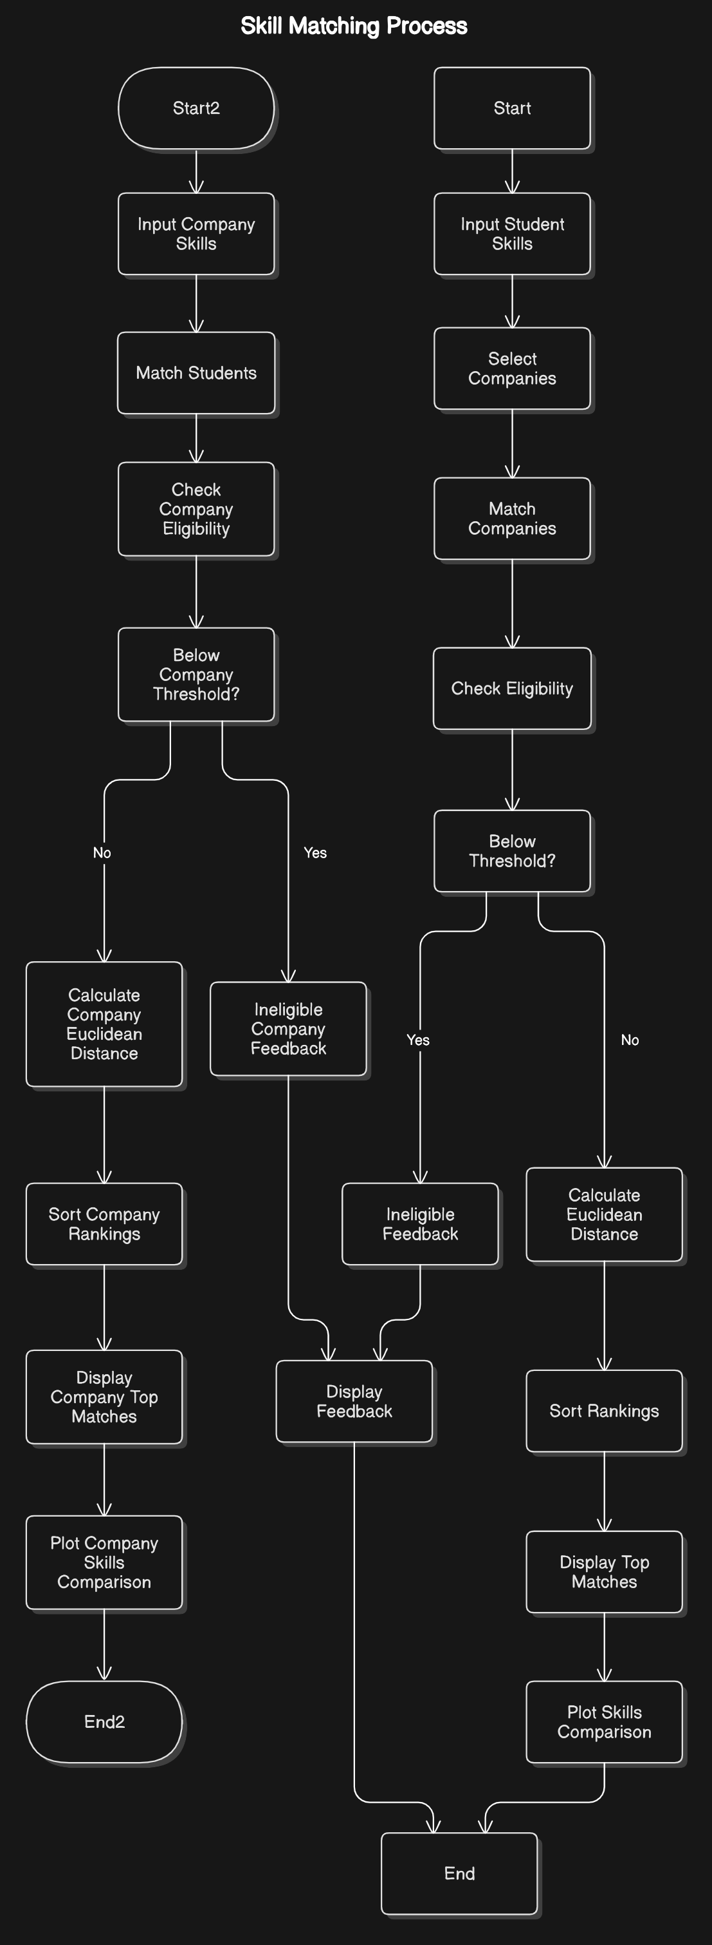
Architecture Diagram

Slide 5
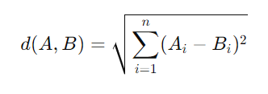
Algorithm Used
K-Nearest Neighbors (KNN)
Description: KNN is used for classification and regression by considering the nearest neighbors in the feature space.
Implementation: The algorithm calculates the distance between students and companies based on their profiles and selects the top KKK nearest company.
Formula:
Euclidean Distance: ​
where A and B are two
points in n-dimensional space.

Slide 6
Skillset
1. Technical Proficiency
2. Project Management
3. Data Analysis
4. Communication & Collaboration
5. Problem-Solving
6. Leadership & Initiative
7. Adaptability & Flexibility
8. Client Relationship Management
9. Research & Development
10. Industry-Specific Knowledge

Slide 7
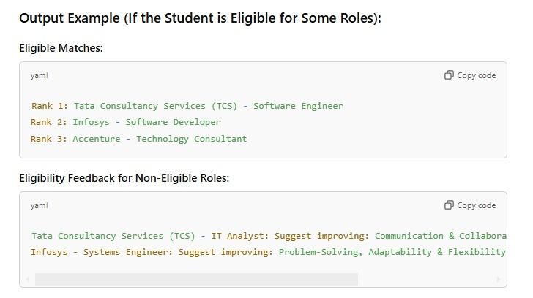
Example Dataset
S=[8,7,6,9,8,7,9,8,7,8]

Slide 8
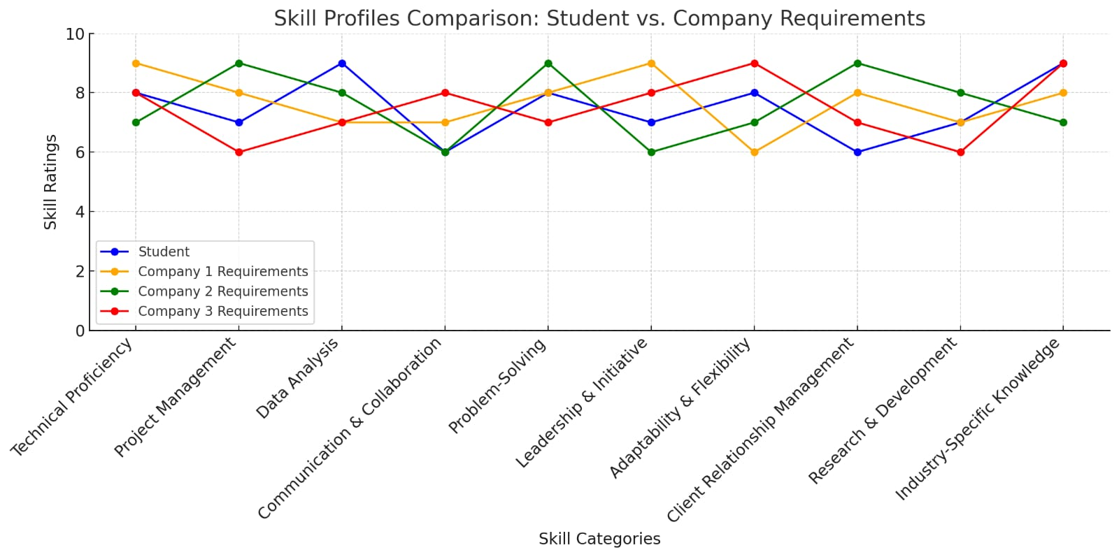
Graph
The graph visually represents how well the company’s requirements align with those of the students skills.

Slide 9
Result
With a distance of approximately 2.83, The closest company- to the student is Mentor 3.
This is critical for the Conexxa system to facilitate effective company-student pairings, enhancing personalized working experiences

Slide 10
Conclusion
This project aimed to bridge the gap between students seeking relevant opportunities and companies in need of specific skills and talent. Moving forward, continuous refinement, user engagement, and feedback integration will be essential to maximize the potential of this system, ultimately fostering a more efficient and supportive environment for both students and companies, ensuring successful matches that benefit both parties.

Slide 11
Thank You

